Slide 1
Language teaching in Malta: finding a balance between
il-Malti lingwa nazzjonali and English
Sandro Caruana
(L-Università ta’ Malta)

Slide 2
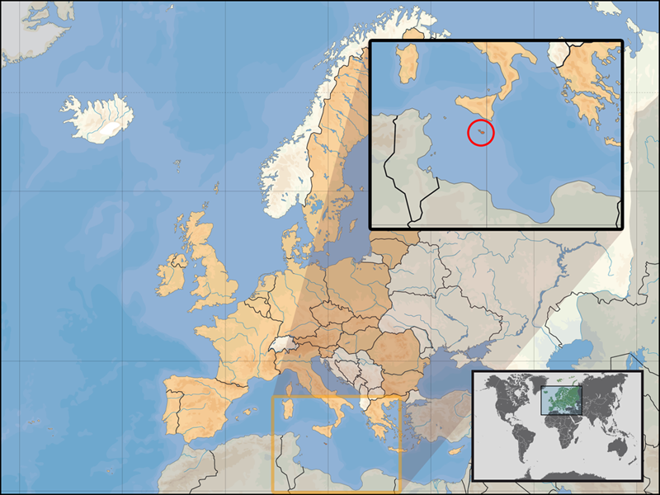

Slide 3
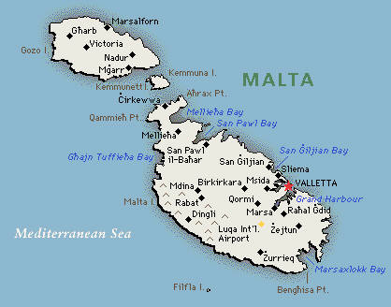
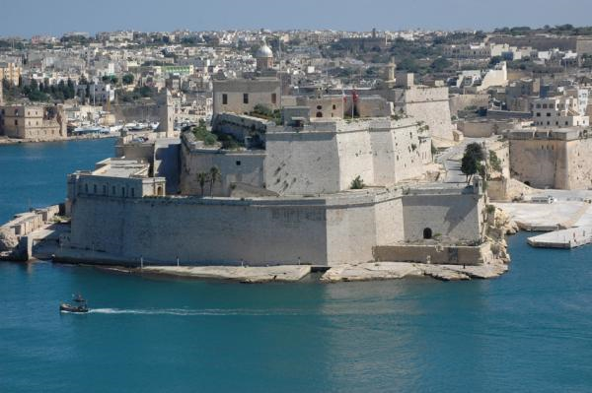
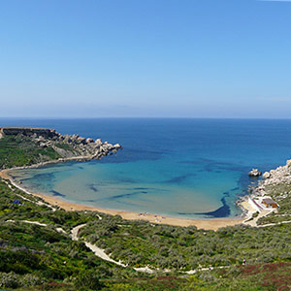

Slide 4
1. An overview of Maltese as a ‘mixed language’ (Aquilina, 1961).
2. Sociolinguistic issues and the linguistic situation in Malta: bilingualism or diglossia?
3. Language policy, planning and teaching: the inclusion of foreign students in the schooling system.

Slide 5
Maltese lexicon is based on the following strata:
a. Semitic (main stratum):
i. triliteral consonantal roots: KiTeB (he wrote); KTieB (book); KiTTieB (author); KiTBa (handwriting); miKTuB (it was written).
ii. Quadriliteral consonatal roots: XaNDaR (he transmitted); XaNDiR (TV programme); imXaNDaR (it was transmitted)
b. Sicilian (superstrate):
induna (addunare, “he noticed”); pitazz (pitazzu “copybook”); maktur (muccaturi “handkerchief”); kexxun (casciuni “drawer”).
c. Italian (adstrate 1)
kanta (he sang); kantant (singer); kanzunetta (song).
d. English (adstrate 2):
kompjuter (computer); ikkompjuterizzat (computerised).
mowbajl (mobile phone); niddawnlowdja (I download)
e. Mixed formation: bilmod (slowly); malajr (fast); kultant (sometimes)

Slide 6
The different strata of Maltese:
Strata | Period | Language | Examples from the semantic sphere of ‘bread’
adstrate 2 | 1800- | English | sandwich, toast
adstrate 1 | 1530- | Italian | panina, panura
superstratum | (1091?) 1184-1900 circa | Sicilian | bezzun, tal-kexxun
main stratum | (870?) 1048-1241 circa | Siculo-Arabic | ħobż (iperonimo); frak, qoxra, dqiq
substrate? | 535-870 218a.C.–476 d.C. 650 a.C. – 50 d.C. | Byzantine Greek Latin Punic

Slide 7
An example of contact (morphology):
Suffixation in plural formation – plural sħiħ (“whole” plural):
Arabic base word | Romance base word | English base word
omm “mother” | patri “priest” | kowt “coat”
omm-ommijiet | patri-patrijiet | kowt-kowtijiet
ħin “time” | siġġu “chair” – | pajp “pipe”
ħin-ħinijiet | siġġu-siġġijiet | pajp-pajpijiiet
Definition of Maltese by a foreigner: “it sounds like a laid back version of Arabic with lots of Italian words”

Slide 8
Arabic, Italian and English lexical strata in Maltese:
(a) Ir-raġel iltaqa’ ma’ oħtu
ART-man met-3MS-PF with sister-his
fid-dar ta’ sieħbu.
in-the-house of friend-his
“The man met his sister at his friend’s house”
(b) Marjo poġġa fuq il-bank tal-klassi .
“Mario si è seduto sul banco di scuola”
NB: poġġa from It. appoggiare
“Mario sat on the school bench”
(c) Hellow Father Patrick, tista’ tessemmessjali n-numru tal-mowbajl ta’ Peter?
“Hello, Father Patrick, could you send me (by SMS) Peter’s mobile phone number?”

Slide 9
Sociolinguistic issues (1)
1. Maltese is the L1 of 90% of the population (Sciriha / Vassallo, 2006).
2. The relationship between Maltese and English: bilingualism? diglossia?
Maltese: national language; Maltese & English: official languages
Local media: TV [+Maltese / - English]; newspapers [Maltese = English]; cinema [+ English / - Maltese]; Internet [+ English / - Maltese...with exceptions, e.g. Chat, emails etc]
Maltese [+spoken variety]; English [+written variety]. This is particularly evident in higher educational institutions

Slide 10
Sociolinguistic issues (2)
3. Sociological considerations:
L1 English speakers may be regarded as ‘snobs’ (tal-pepè).
The use of English depends heavily on:
the social context (+ formal / + English), including interlocutors and social network (in ‘neutral’ situations one would opt exclusively for Maltese).
The school one attends / has attended (e.g. private schooling = English; public schooling = Maltese)
Maltese & English are both vehicular languages in schools,the choice depends on various factors.

Slide 11
Policies and planning
Within this context of dynamic language change what happens at official, institutional level?:
There is the official legislation (including policies implemented in educational institutions) which determines and regulates the use of the two languages in Malta.
There are a number of official organisations (Akkademja tal-Malti, Kunsill Nazzjonali tal-Ilsien Malti etc.) whose role is mainly to regulate and safeguard the Maltese language.
But.... there is no clear policy regarding the inclusion of children with migrant backgrounds in Maltese schools.

Slide 12
The National Minimum Curriculum
The National Minimum Curriculum considers bilingualism as the basis of the educational system.... equal importance should be given to the teaching of the first and second languages at all levels.
Primary Level (age 5-11) The National Minimum Curriculum encourages teachers at this level to use English when teaching English, Mathematics, Science and Technology. In classroom situations when teaching these subjects in English poses difficulties, code switching can be used as a means of communication.
Secondary Level (age 12-16) This document recommends that:
- teachers of Maltese, Social Studies, History, Religion and PSD teach these subjects in Maltese;
- teachers of foreign languages teach in the language in question; and
- teachers of the remaining subjects teach in English.
Only in those cases where this poses great pedagogical problems, does the National Minimum Curriculum accept code switching as a means of communication

Slide 13
... language contact in the classroom (1)
Mathematics lesson (T=teacher; S=student)
S: ma jnaqqsulekx marki
T: no no no you won’t lose marks...imma if possible... to show you know what you are really doing...nippruvaw inniżżlu it-two mal-ewwel...immediately mal-ewwel inniżżluha t-two...kif qed nagħmel il-formula inniżżlilha anzi mal-formula għax għalhekk qed nagħmel semicircle...biex jiena hawnhekk inniżżel it-two mal-ewwel ...orrajt ...yes
S: they won’t deduct marks from you
T: no, no, no you won’t lose marks... but if possible...to show you know what you’re really doing...we try to write the number two immediately. Immediately, we immediately write down the number two. While I am working the formula I write it down or rather at the same time as the formula because this is why I draw a semicircle, so that I write number two here right away. Alright. Yes.
(example taken from Camilleri, 1995: 116-117)

Slide 14
... language contact in the classroom (2)
Italian lesson (T=teacher; S=student)
T: scomparsa + ? che significa scomparsa ? + *? tal-maġiks hekk ?*
S: *[ sir sir *
T: [ ? è sparita ] +++ john
S: * sparixxiet *
T: scomparsa, what does scomparsa mean, by doing magic, just like that?
S: sir, sir (tries to get teacher’s attention)
T: è sparita?, John
S: she disappeared

Slide 15
Immigration towards Malta (information from official sources, published in the Times of Malta in 2009-2010)
4.4 per cent of Malta's population in 2009 consisted of foreigners according to statistics issued in Brussels by Eurostat, an increase of 3,100 over 2008.
According to the figures, in 2009 there were 18,100 foreign residents in Malta: 8,200 coming from other EU member states and 9,900 from non-EU member states.
Although the number of foreign residents in Malta is high when compared to Malta’s population, (which in 2009 stood at 414,000), it is not as high as the average in the EU.
The figure of non-EU individuals who currently hold a permit to reside in Malta surpasses by at least 3,000 the total number of African immigrants currently believed to be in Malta.

Slide 16
Immigration towards Malta
Nationalities of top 10 non-EU residence permit holders in Malta:
Serbia:1,011
Russia: 899
China: 795
Libya: 697
India: 463
Philippines: 413
Ukraine: 409
Turkey: 343
Bosnia and Herzegovina: 243
Korea: 217

Slide 17
Foreign students enrolled in Maltese Primary & Secondary schools 2010-11 Total = 565
Nationality | Number | %
UK | 173 | 30.6
Bulgaria | 58 | 10.2
Serbia | 32 | 5.6
Russia | 22 | 3.9
Italy | 19 | 3.4
Ukraine | 17 | 3

Slide 18
The problems these students face:
There is a major distinction between those foreigners in our school who know English and those who do not.
The few who do not know English are immediately singled out as ‘different’. Needless to say, this has repercussions on them, both socially and in their studies.
They come face to face with an intricate linguistic situation with Maltese and English used in very different domains. These are clear-cut for locals, but not so evident to foreigners.
There is no specific policy regarding their integration in schools so for those who know neither Maltese nor English (at least during the initial months of their stay) it is a very much a case of ‘learning to adapt’.

Slide 19
...and the solutions? (1)
Most initiatives are largely based on individual schools’ and teachers’ good will. Many of these are extremely laudable and do yield positive results.
The main advantage is constituted by the fact that individual attention can be given to these children.
Preliminary research, however, does show that there are major differences in students who join the schooling system at Primary level ("I still play with children, even if I don't understand what they're saying," eight-year-old Thomas) and others who join at Secondary level ...in the latter case there have been cases of unruly students and their misbehaviour is clearly related to their frustration in not being able to communicate.

Slide 20
...and the solutions (2)
Generally priority is given to helping them obtain a level of proficiency in English. However, they are also introduced to Maltese as this is extremely important to help them feel integrated locally.
There are some materials which are used in order to teach Maltese to these foreign students.
Materials used in order to teach English are not locally produced.
Undoubtedly this is a new situation which Malta is still coming to grasps with and which warrants immediate measures, especially in view of the increase of foreign students in our schools over the recent years.

Slide 22
Conclusions
The situation of the Maltese language is highly dynamic, with both ‘internal’ and ‘external’ changes.
It is clear that integrating children with migrant background is not an easy task: they come face to face with a diversified language context in which the interplay of two languages has very clear-cut boundaries which are not easily recognisable for those who are not integrated into the Maltese society.

Slide 23
Conclusions
In some circumstances educational policies are based on a clear-cut dichotomy between the two languages: this renders them distant from what occurs in everyday life as bilingualism/diglossia, as well as language contact and language change, have always been an inherent feature of the Maltese sociolinguistic situation.
Teaching English to children with migrant background is the ‘easy’ solution. Is this enough? I quite honestly believe not ....
Grazzi ħafna tal-attenzjoni!

